Slide 1
Handwritten Digit & Character Recognition

Slide 2
By 20SE02ML032-Fenil Patel 20SE02ML033-Krunal Patel 20SE02ML050-Jeel Vaghani
Under the mentorship of
Mr. Aakash Gupta

Slide 3
Questions about this Project
What is Handwritten Digit & Character Recognition ?
In which language it is carried out ?
What is the Requirement ?
How it will worked ?
How much work is carried out ?
What is the Expected Output ?

Slide 4
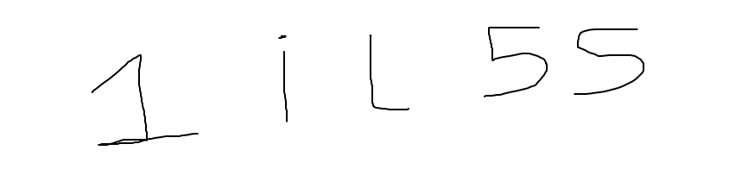
What is Handwritten Digit & Character Recognition ?
This project is made to predict the accuracy of the handwritten digit and character to recognise the difference between the Digit and Character.
In Alphabets and Numeric system some digit and characters are likely same in written form. For example I and 1 ,l and 1 ,5 and S etc.
Now this example in handwritten form :--

Slide 5

In Which language it is carried out ?
This project can be done in many IDE like google Colab , Jupyter notebook, Anaconda etc.

Slide 6
What is the Requirement ?
The modules required to do this projects is :--Numpy, Pandas, CV2 , Keras , Sklearn, Matplotlib, Seaborn
Dataset required are :-- A-Z Handwritten Alphabets in .csv format
MNIST Dataset from keras in .csv format

Slide 7
How it will worked ?
This project will work in three form structure :--
1.Data Preprocessing
2.CNN Architecture
3.Application model

Slide 8
Data Preprocessing
In this structure the dataset of A-Z Handwritten Alphabets & MNIST Dataset will be load.
The main motive of data preprocessing is to combining the both data in one file format with its all train and test data in it.

Slide 9
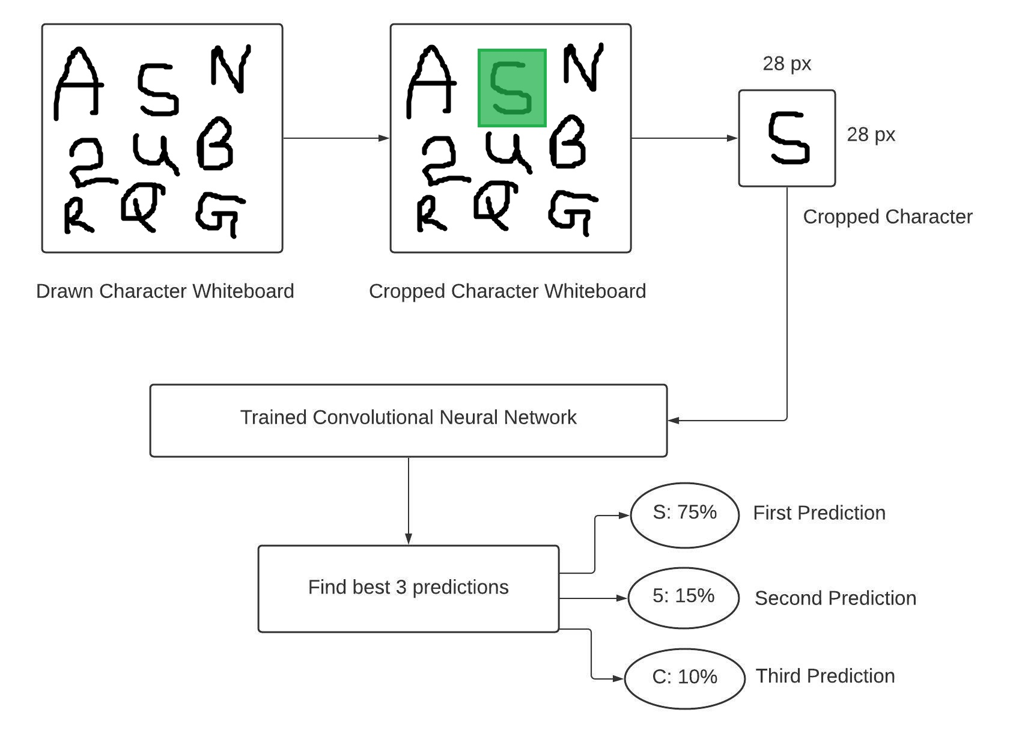

Slide 10
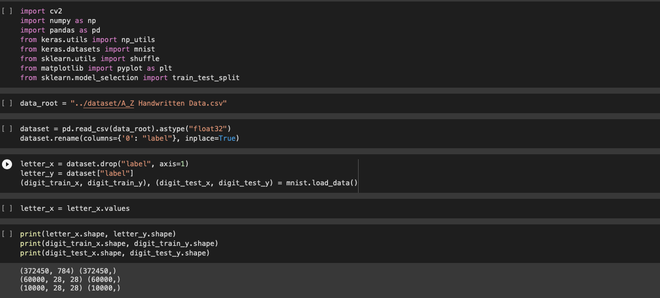
Data Preprocessing

Slide 11
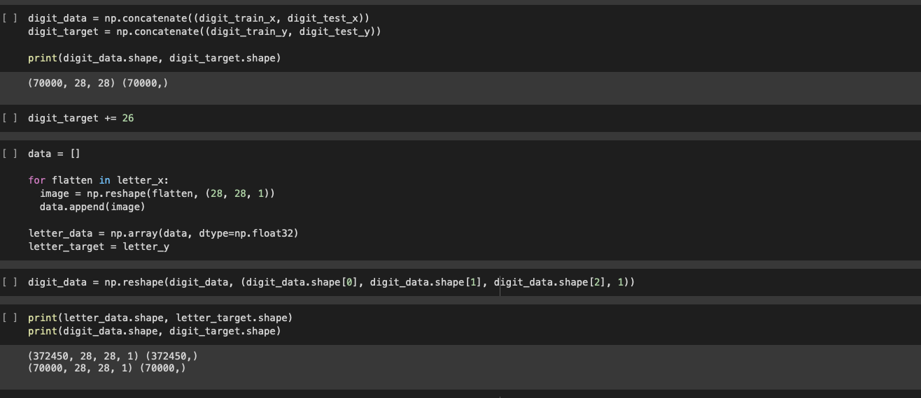

Slide 12
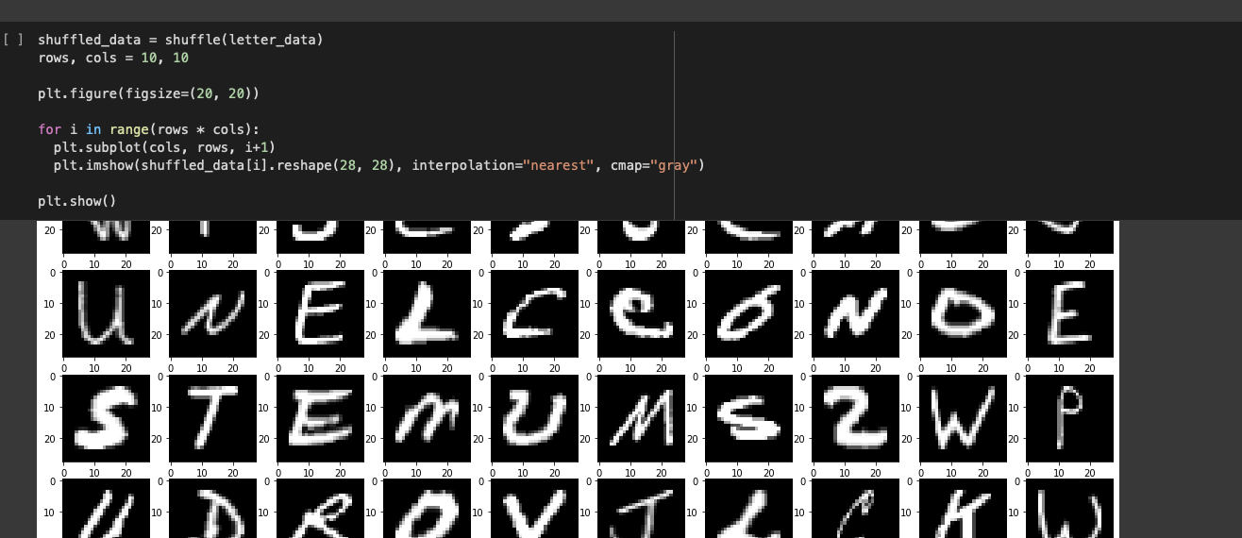

Slide 13
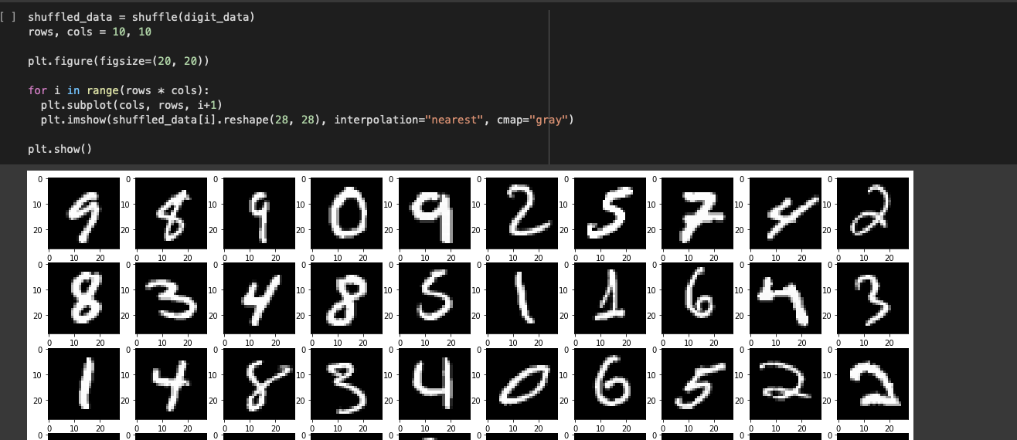

Slide 14
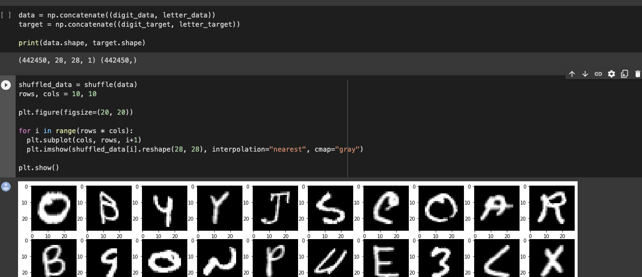

Slide 15
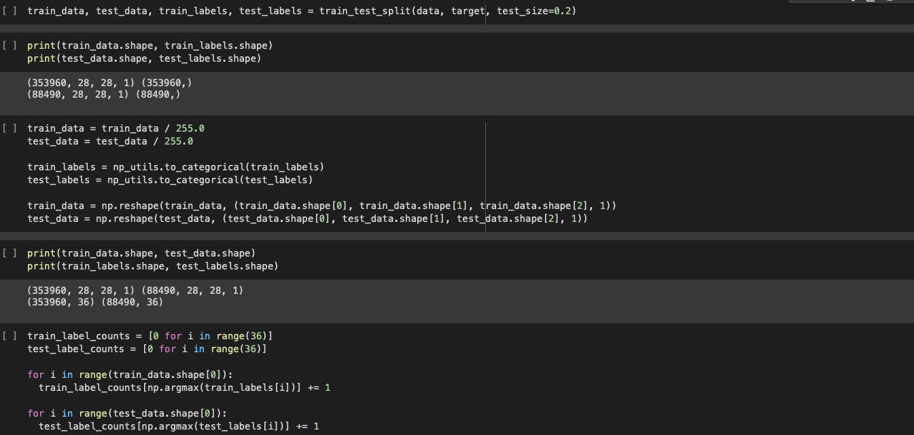

Slide 16
CNN Architecture
In this structure we will train our new dataset which is the combining form of A-Z Handwritten Alphabets & MNIST Dataset in image of 28*28 pixels.
A convolutional neural network ( CNN ) is a type of artificial neural network used in image recognition and processing that is specifically designed to process pixel data .

Slide 17
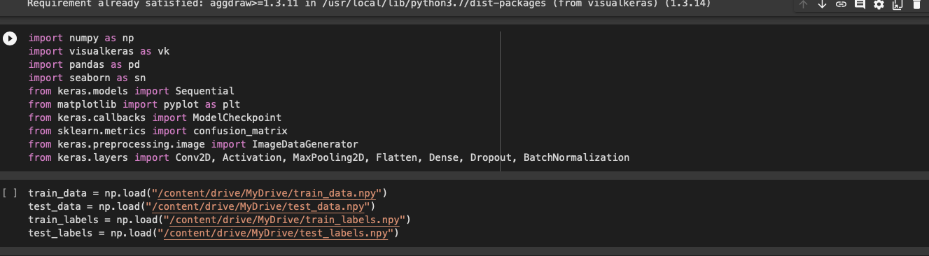

Slide 18
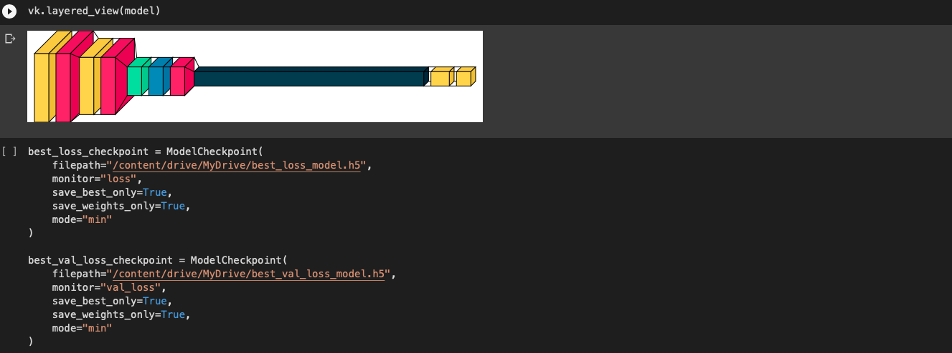

Slide 19
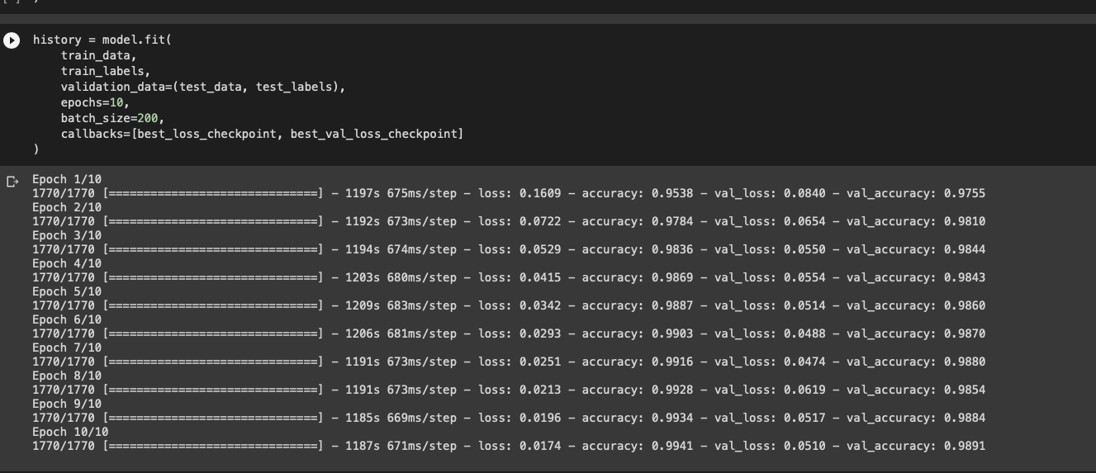

Slide 20
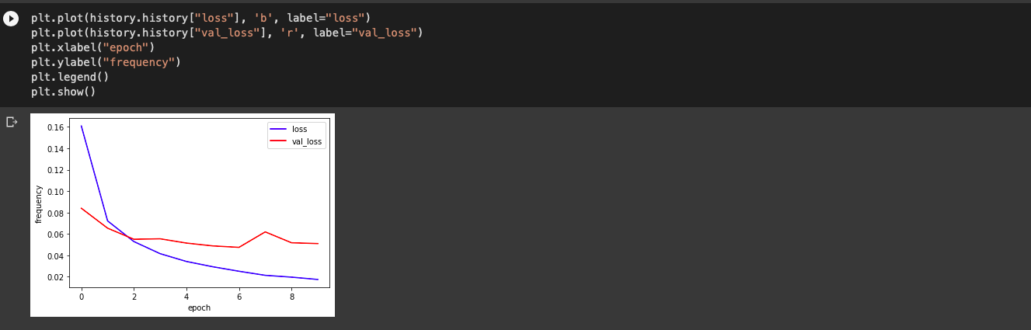
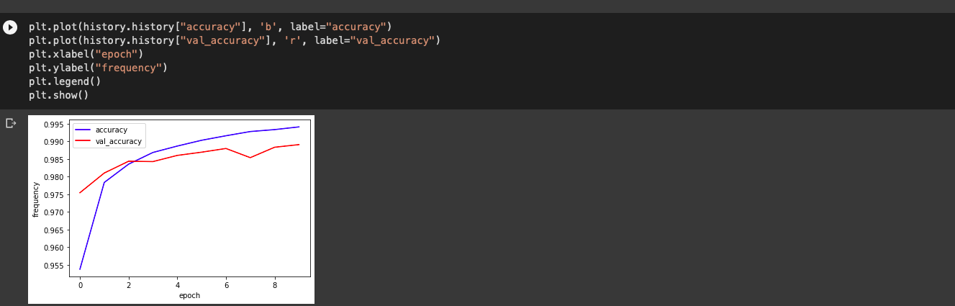

Slide 21
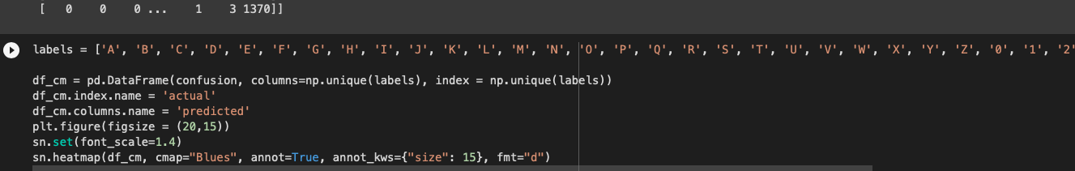

Slide 22
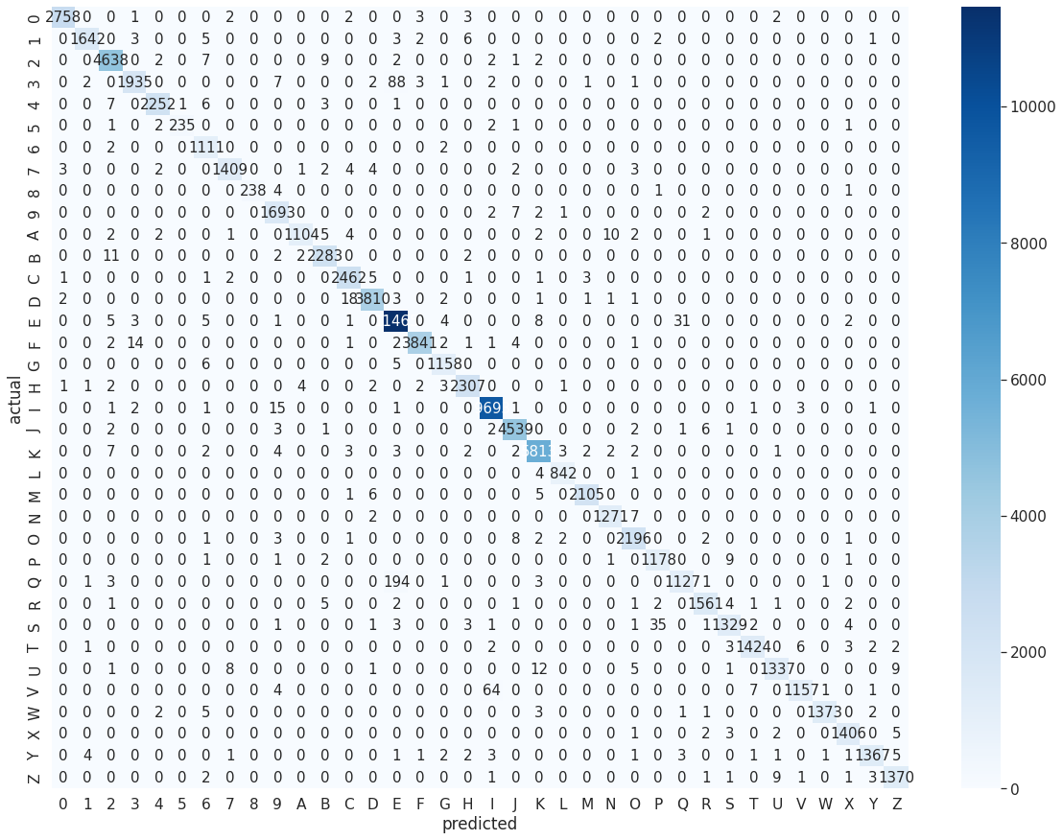

Slide 23
Application
This is the final step for my project “the application window”.
In this window we will make a whiteboard where we can draw our digit and characters.
Then we will crop that drawing and placed it in our other whiteboard in this window .
After drawing and cropping the CNN will calculate the accuracy for that object being cropped and give us three best prediction.

Slide 24
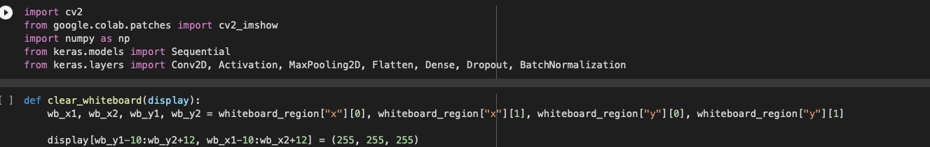

Slide 25
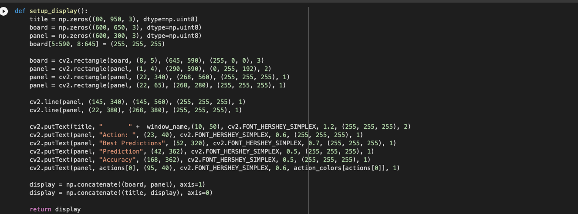

Slide 26
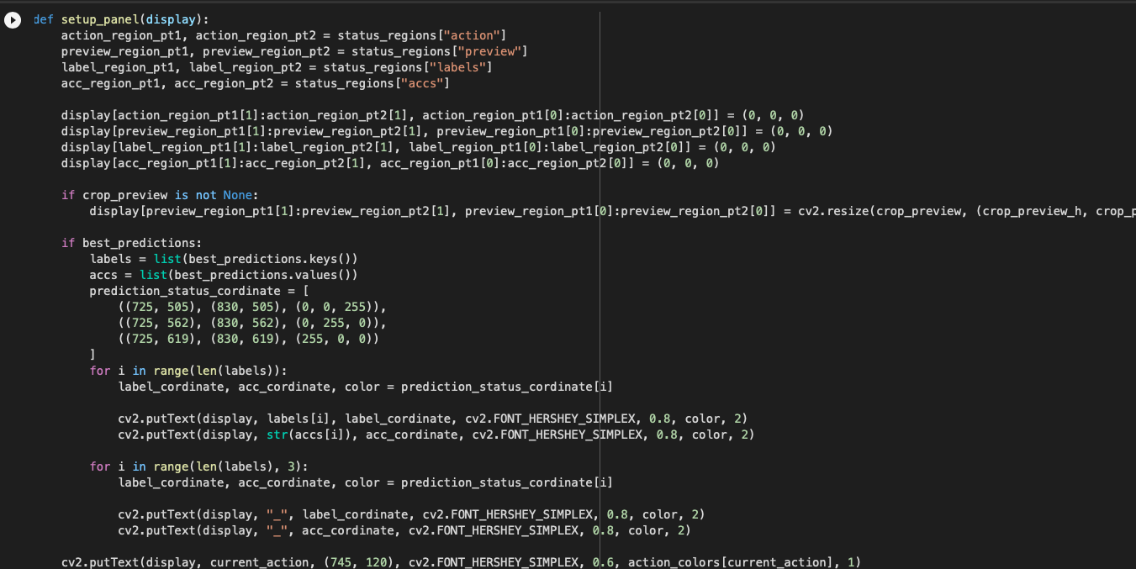

Slide 27
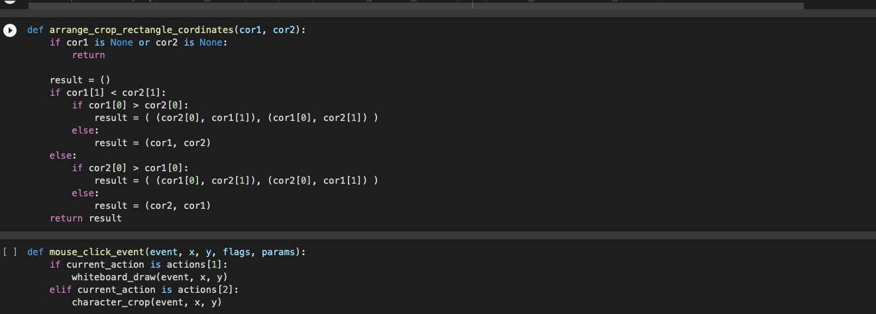

Slide 28
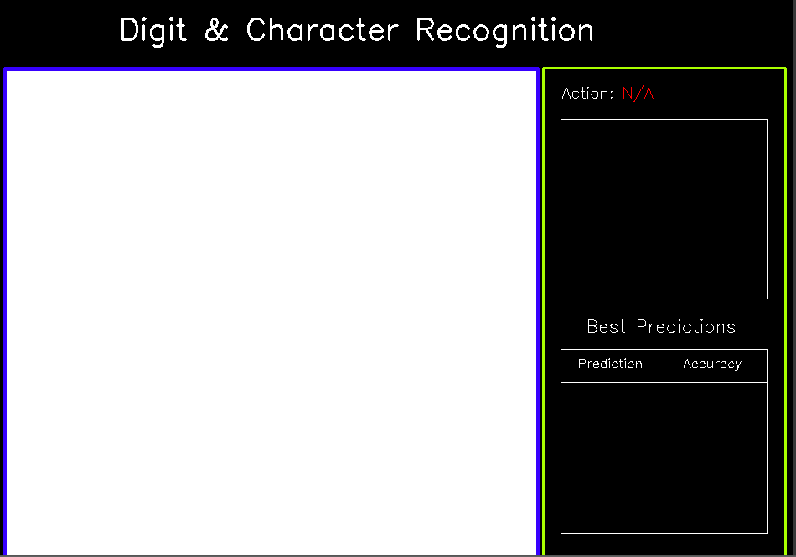

Slide 29
Expected output

Slide 30
